Slide 1
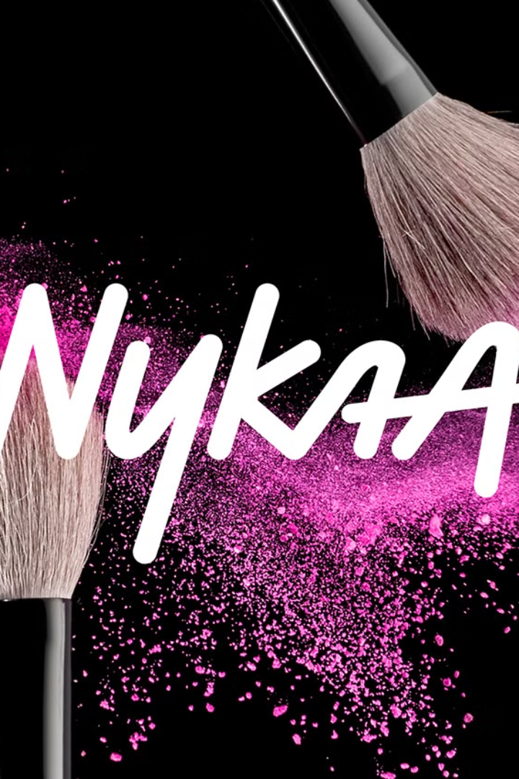
Nykaa’s Business Analysis
Presented By
Abubakkar Siddiq

Slide 2
Nykaa: A Leader in B2C E-Commerce
Overview
Business Model
• Industry: B2C E-Commerce • Founded: 2012 by Falguni Nayar • Headquarters: Mumbai, India
• Type: B2C (Business-to-Consumer) • Core Focus: Beauty, Personal Care, and Fashion • Omnichannel Presence: Online platform and physical stores
Key Highlights and Achievements
1
Product Range
2
Private Labels
4,000+ brands, 2.5M+ products
Nykaa Cosmetics, Naturals, Kay Beauty
3
IPO
4
Expansion
2021 – Successful public listing
Nykaa Fashion, international shipping

Slide 3

Key Focus Areas
Brand Perception
Customer Satisfaction
Market Trends
Competitive Landscape
Understanding how customers perceive Nykaa is crucial for shaping brand strategy and messaging.
Measuring customer satisfaction levels is essential for identifying areas for improvement and building loyalty.
Staying abreast of evolving market trends is vital for adapting product offerings and marketing strategies.
Analyzing competitors' strengths and weaknesses helps Nykaa maintain a competitive edge.

Slide 4
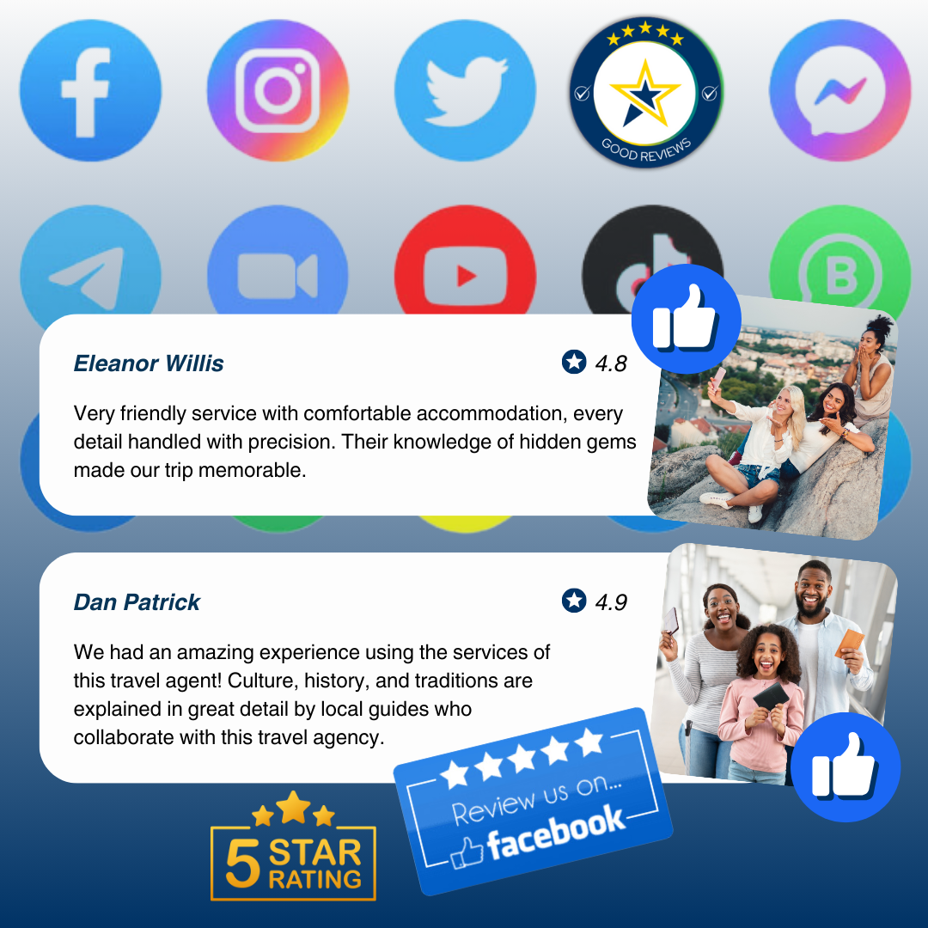
Data Sources and Collection Methods
Social Media Platforms
Review Sites
E-commerce Platforms
Twitter, Instagram, and YouTube
Trustpilot and Play Store Reviews
Reviews from Flipkart and Amazon

Slide 5
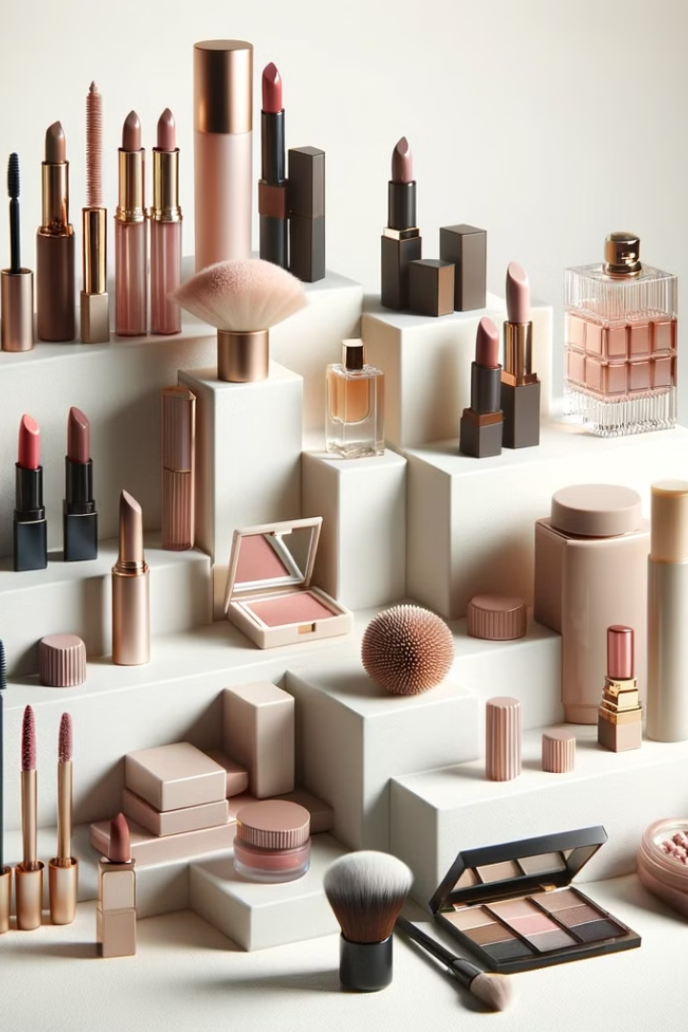


Brand Perception Analysis
Positive
Negative
Reliable, stylish, wide product range, high-quality, smooth shopping experience, fast delivery, good pigmentation (cosmetics).
Poor service, damaged/fake products, delayed deliveries, rude staff, unresolved issues, security concerns.

Slide 6
Common Descriptors
Negative Descriptors
Positive Descriptors
• Poor service, damaged/fake products, delayed deliveries, rude staff, unresolved issues, security concerns.
• Reliable, stylish, wide product range, high-quality, smooth shopping experience, fast delivery, good pigmentation (cosmetics).
Common Sentiments
Negative Sentiments
Positive Sentiments
• Frustration, disappointment, distrust, anger over poor service, delayed deliveries, and product issues.
• Satisfaction, appreciation, trust in Nykaa, excitement for new products.

Slide 7
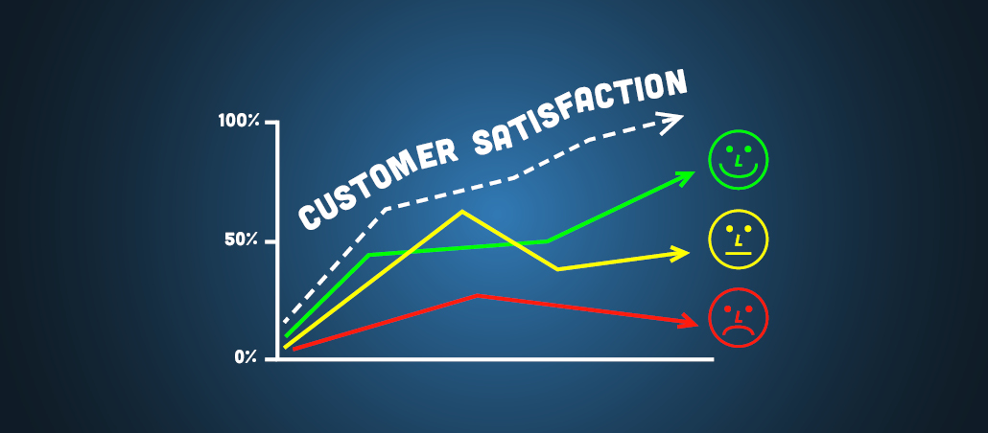
Customer Sentiment Analysis
1
Customer Service Issues
Complaints about unhelpful support, unresolved issues, and slow responses.
2
Delivery & Order Issues
Delays, incorrect products, missing items, and difficulty with returns.
3
Product Quality Concerns
Faulty or fake products, damage, or incorrect items received.
4
App/Technical Problems
Navigation and functionality issues with the app.

Slide 8



Sentiment Summary
Negative Sentiment
Customer Service Failures: Unresponsive support, poor resolutions.
Delivery Delays: Late or incorrect deliveries, missing items.
Product Issues: Faulty products, poor quality, wrong orders.
Returns/Refund Problems: Difficulty in processing returns, delayed refunds.
Positive Sentiment
Product Quality: Good pigmentation, smooth application, long-lasting.
Fast Service: Reliable delivery, good shopping experience.
Good App/Website: User-friendly, smooth experience for cosmetics and beauty products.

Slide 9
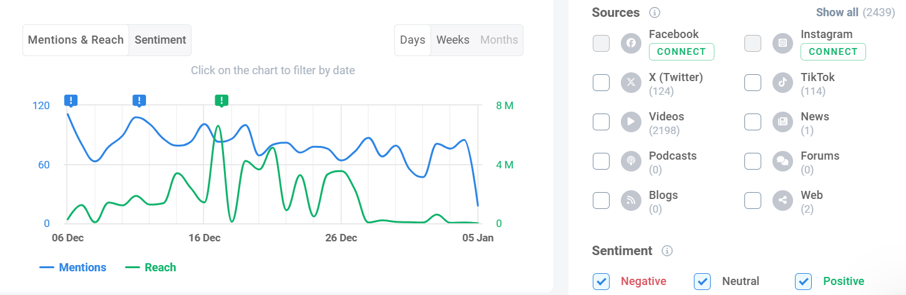
Leveraging Market Insights with Brand24
Utilized the Brand24 platform to analyze market trends and assess public sentiment toward Nykaa.

Slide 10

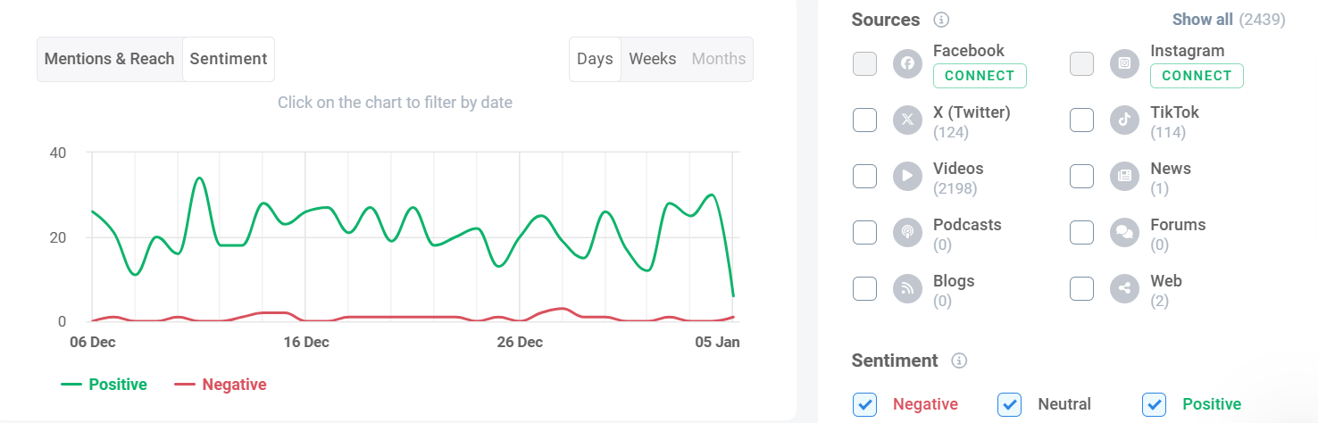
Market Sentiment Towards Nykaa

Slide 11

Nykaa vs. Competitors
1
2
Purplle
Myntra
A direct competitor offering a wide range of beauty, personal care, and grooming products with a strong online platform and a focus on affordability.
While primarily a fashion e-commerce platform, Myntra has expanded its beauty and personal care segment, leveraging its existing customer base and strong brand presence.

Slide 12

Comparative Analysis of Nykaa, Myntra, and Purplle
Aspect
Nykaa
Myntra
Purplle
Core Focus
Beauty, personal care, wellness, fashion.
Fashion and lifestyle; beauty secondary.
Beauty and personal care.
Target Audience
Women-centric, beauty enthusiasts.
Fashion-conscious, diverse demographics.
Price-sensitive, younger beauty consumers.
Strengths
Strong brand in beauty; omnichannel model.
Market leader in fashion; Flipkart backing.
Affordable pricing; personalized offerings.
Weaknesses
Heavily reliant on beauty category.
Beauty is not the primary focus.
Limited physical presence; smaller scale.
Opportunities
Men’s grooming, international expansion.
Tier 2/3 growth; private labels.
Tier 2/3 expansion; vegan/clean beauty.
Threats
Competition from Myntra, Purplle, Amazon.
Competition from Nykaa, Ajio, Amazon.
Intense rivalry with Nykaa; limited scale.

Slide 13
Comparative Analysis
Aspect
Nykaa
Myntra
Purplle
Product Range
Extensive in beauty, personal care, and wellness; includes premium, mid-range, and affordable options.
Broad range of fashion; growing beauty and personal care category.
Focused on beauty and personal care; budget-friendly and mid-range products.
Pricing
Offers a mix of premium, mid-range, and affordable pricing; frequent sales.
Competitive pricing, especially during seasonal sales; higher-end fashion products available.
Affordable pricing, frequent discounts, and combo offers.
Customer Satisfaction
High for beauty products due to quality and curated offerings; slightly mixed for Nykaa Fashion.
High for fashion; limited feedback on beauty segment.
Good for budget-friendly beauty products; limited premium options may impact satisfaction.
Social Media Presence
Strong on Instagram, YouTube, and Twitter with influencer collaborations and engaging campaigns.
Strong on Instagram and YouTube for fashion; less active in beauty content.
Active on Instagram and YouTube; focused on tutorials, offers, and budget-friendly campaigns.

Slide 14
Nykaa’s Strengths and Weaknesses
Strengths
Weaknesses
Poor Customer Service: Unhelpful and unresponsive support
Refunds Processed: Some positive experiences with refunds
Product Availability: Variety and timely delivery mentioned positively
Order Issues: Incorrect, damaged, or counterfeit products
Delivery Delays: Long wait times and lack of updates
Wide Product Range: Extensive variety in cosmetics and beauty products.
Deceptive Practices: Misleading product descriptions and images
Positive Experiences: Some customers praise trustworthiness, offers, and speedy deliveries.
Technical Glitches: App and payment issues disrupt shopping.
Convenient Shopping: User-friendly platform with attractive promotions.

Slide 15






Strategic Recommendations
Enhancing Customer Support
Strengthening the Supply Chain
Instituting Stricter Quality Control Measures
Streamlining the Return and Refund Process
Through training and faster response times.
To ensure timely and accurate deliveries.
To build trust and repeat business.
To avoid fake or defective products.
Improving Data Security and Privacy Protocols
Addressing Employee Concerns
To reassure customers.
To foster a positive workplace culture, reflecting positively on customer interactions.

Slide 16
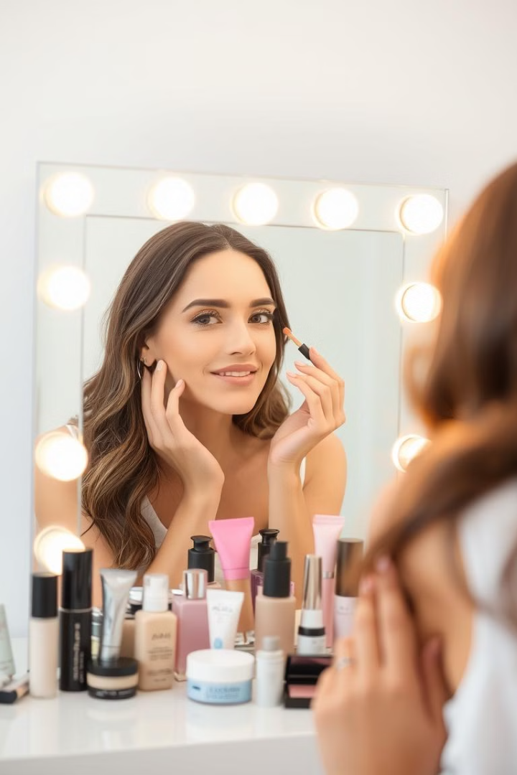
CONCLUSION
This analysis indicates that while Nykaa has strong points, particularly in its product offerings and brand recognition, addressing operational and service-related weaknesses will be crucial for sustained growth. Implementing the recommendations will enable Nykaa to overcome its operational and service-related challenges. Enhancing customer support, strengthening supply chain efficiency, enforcing stricter quality control, and streamlining return processes will improve customer trust and satisfaction. Additionally, prioritizing data security and fostering a positive workplace culture will solidify Nykaa's reputation and pave the way for sustained growth and competitive advantage in the e-commerce industry.

